Slide 1
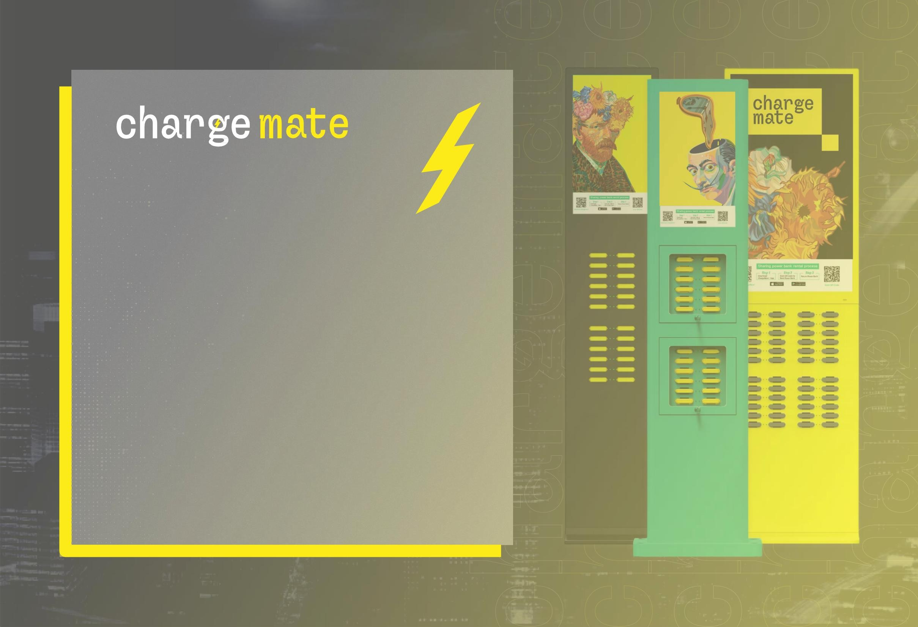
Machine Translated by Google
Urban charging rental
service

Slide 2
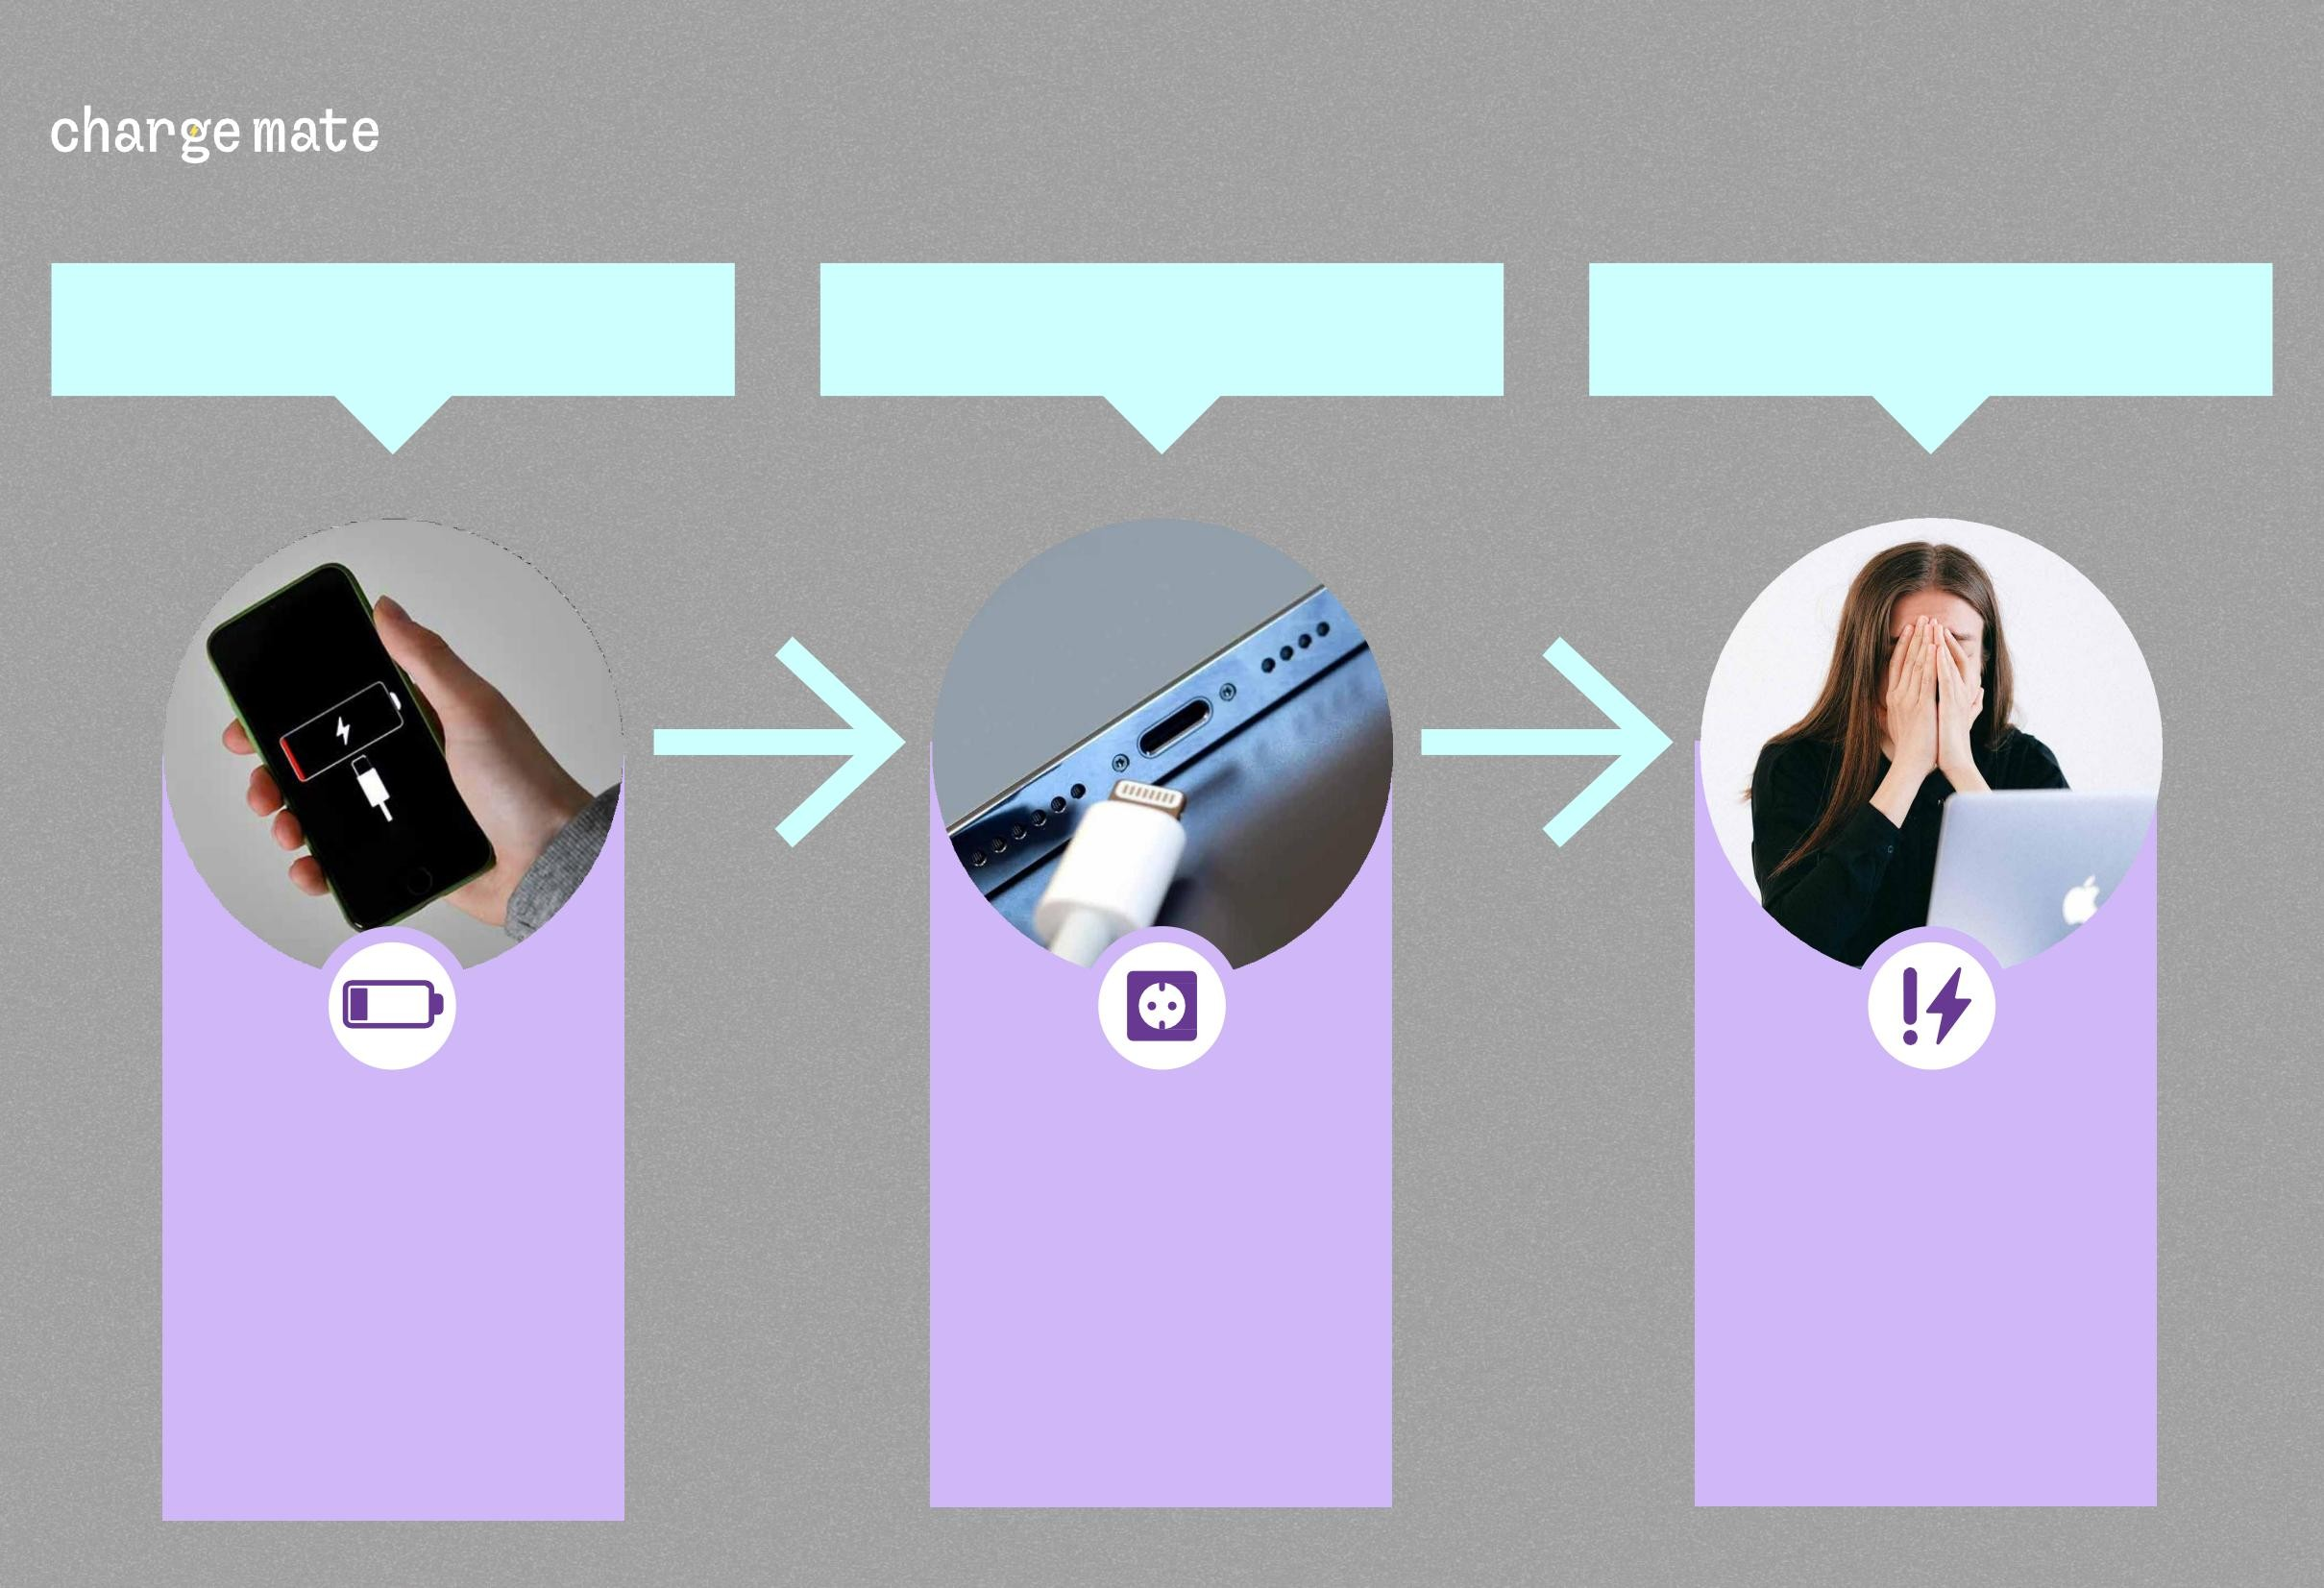
PROBLEM #1
Machine Translated by Google
BUSINESS OVERVIEW AND DEMAND
PROBLEM #2
PROBLEM #3
The
phone charger is not always
included, and
PSYCHOLOGICAL PANIC 20%
at
According
to LG survey -
BATTERY DRAINS
QUICKLY.
sometimes
there may not be a plug on site.^{"Low Battery Anxiety".}

Slide 3
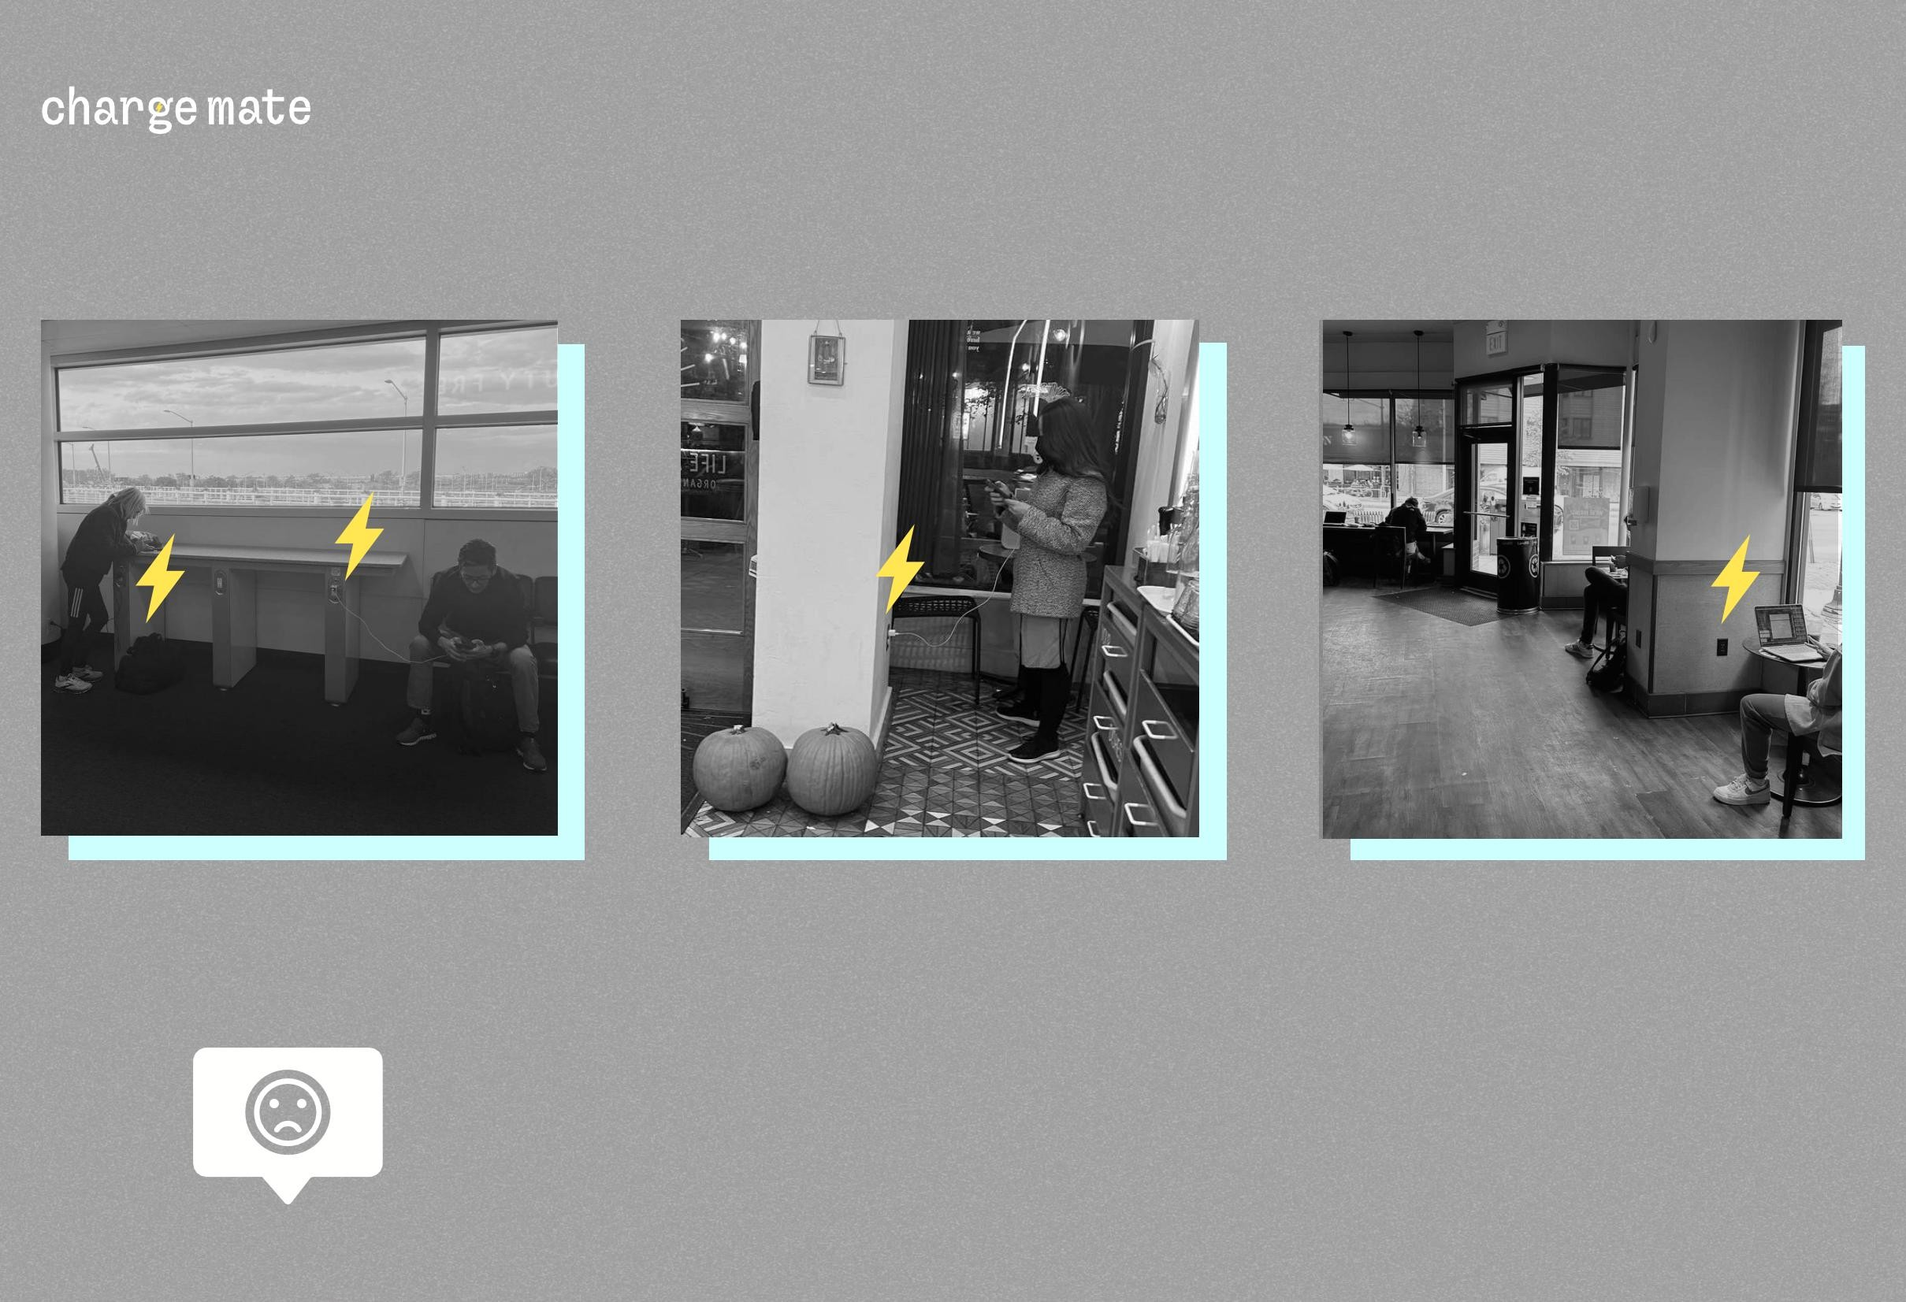
Machine Translated by Google
Business overview and demand
About 60% of people who have a battery bank do not take it with them.
A typical situation on the streets of Boston.

Slide 4

Happy customers,
Machine Translated by Google
lower costs
Chargemate does not have to buy, rent or distribute external batteries to customers.
Today, asking the waiter for a charger is as natural as asking for a table by the window
Customers can use the modern service without the help of an attendant.
Additional benefits from integrations, increased loyalty and engagement of guests.

Slide 5
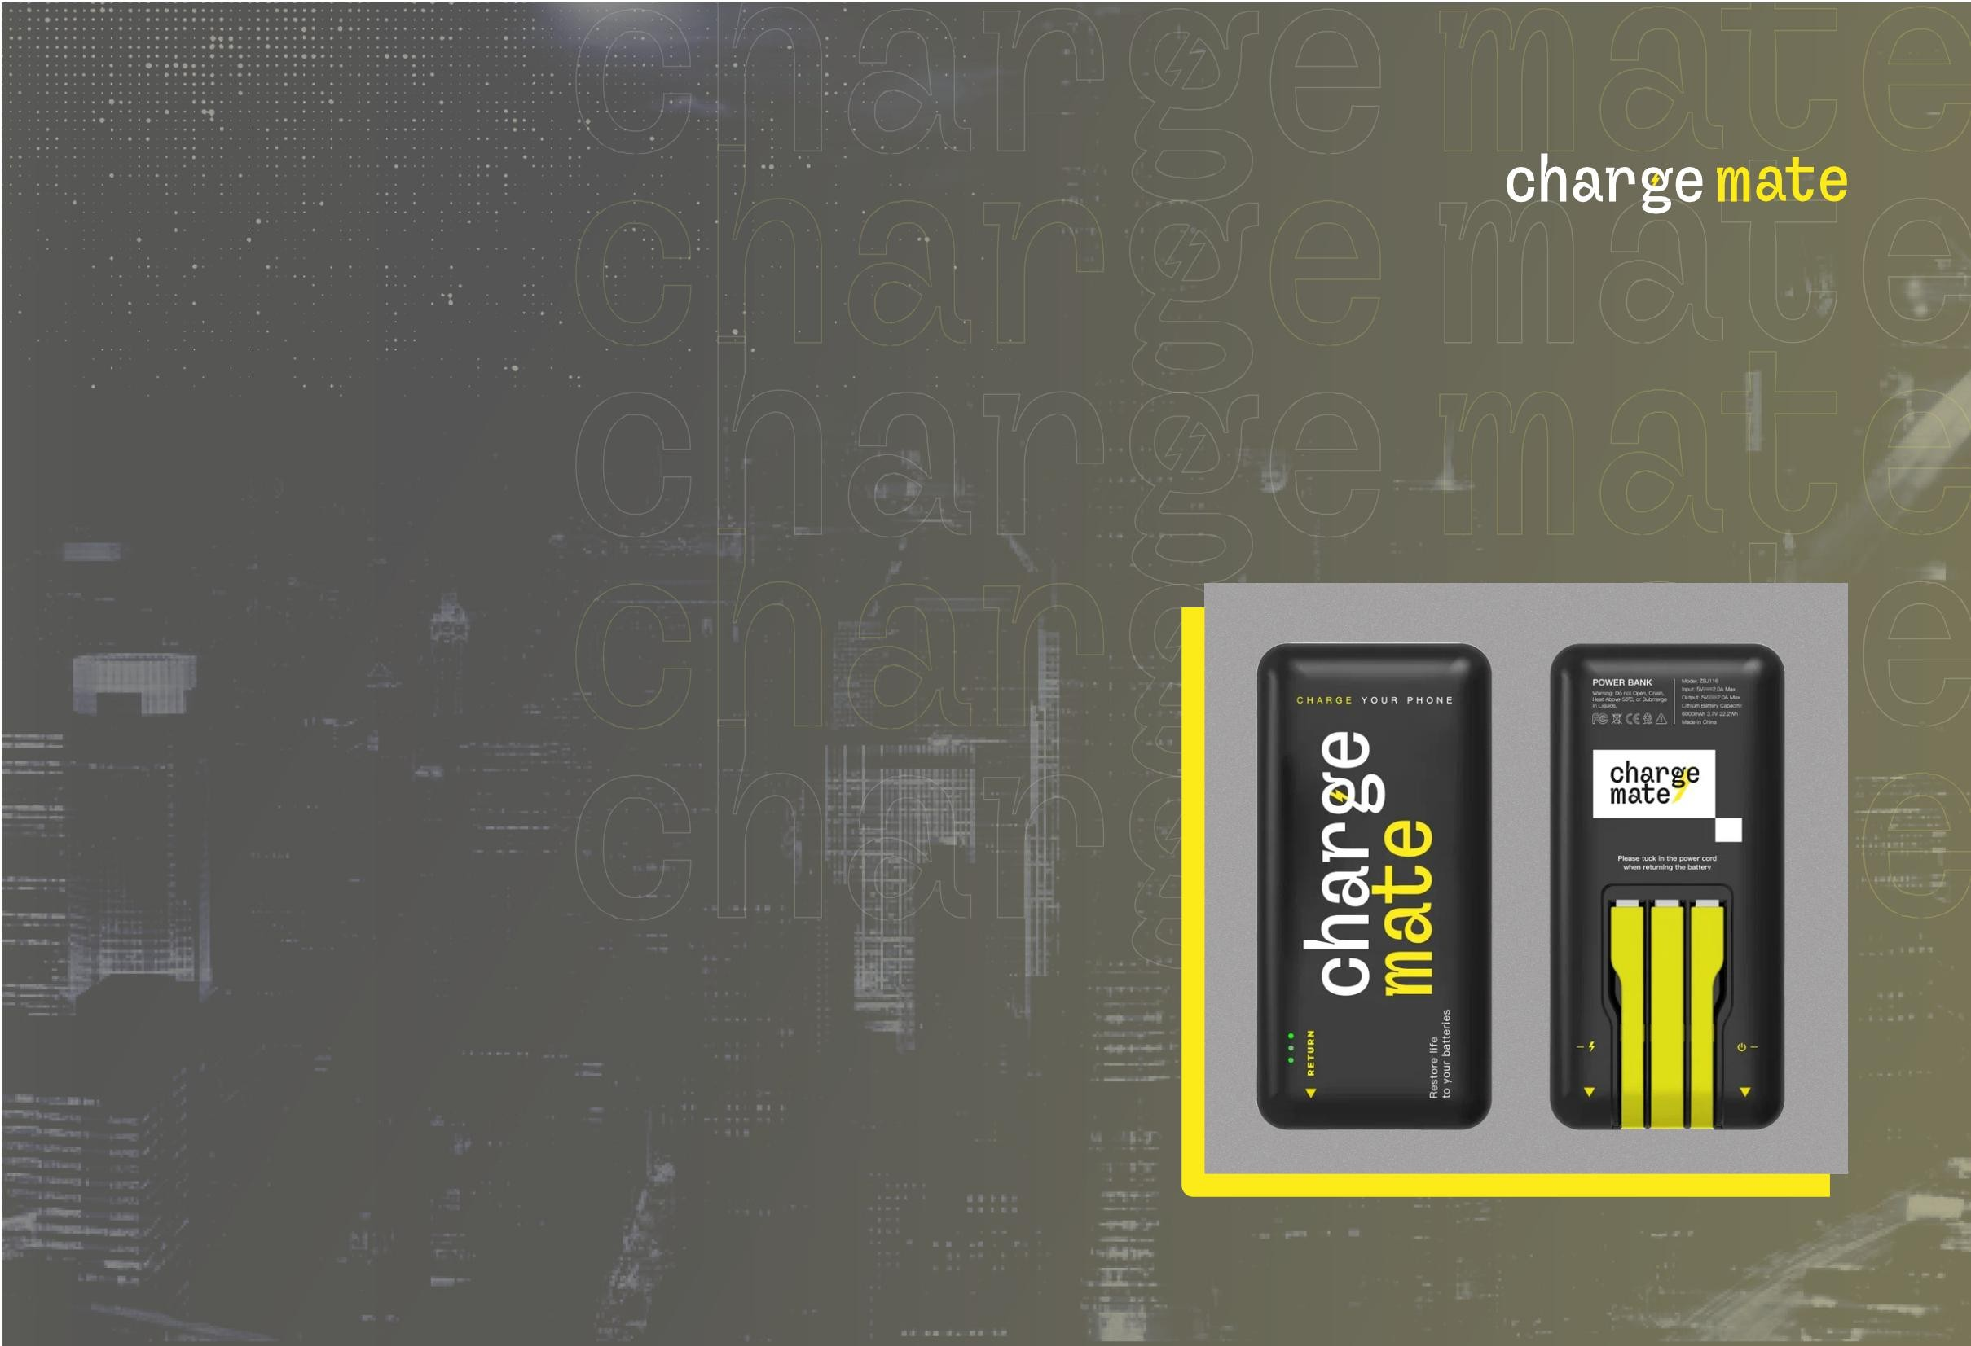
Benefits of our
Machine Translated by Google
service
Technological service for visitors.
Ergonomic design.
3
4
Charges a full battery in one hour.
Costs less than a cup of coffee.
5 The wires are in the charger
built-in.

Slide 6
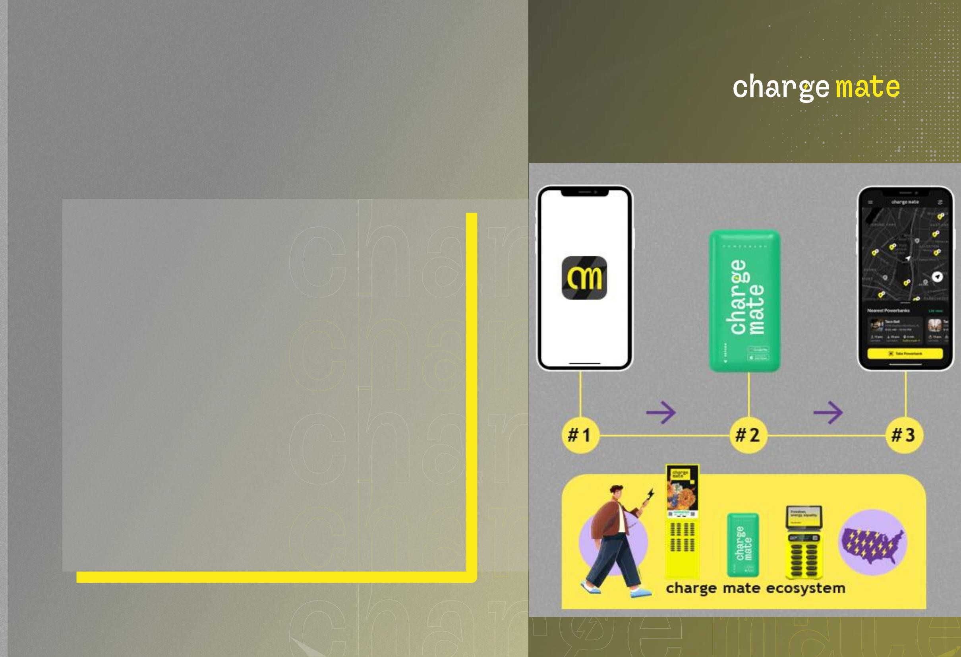
How to use
Machine Translated by Google
1
2
3
4
Download the app.
Scan the QR code on the screen.
Take a battery bank with you.
Return the battery bank
to another charging station.

Slide 7
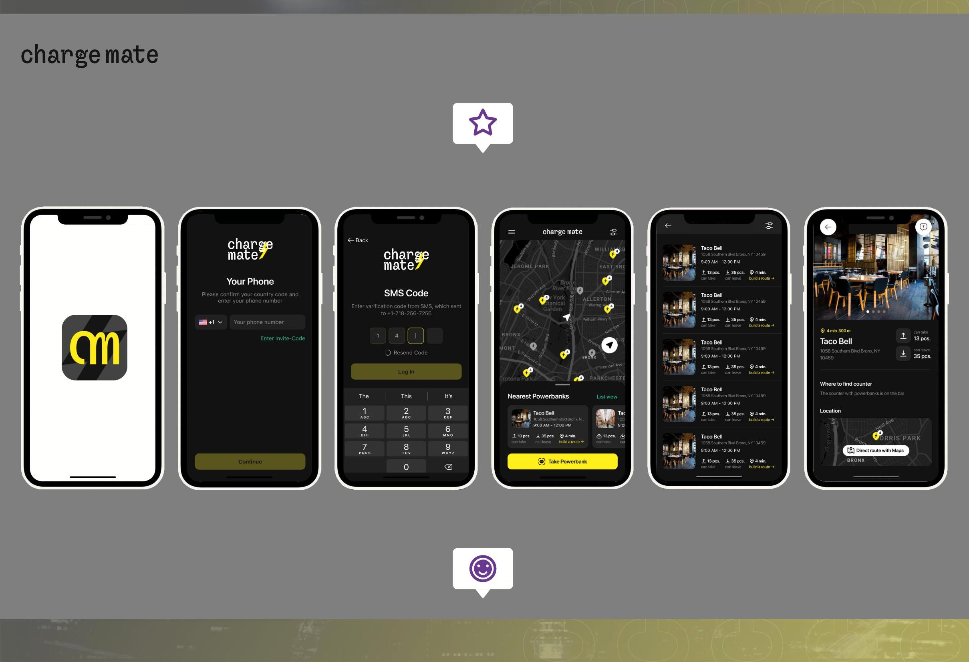
Machine Translated by Google
COMPETITIVE ADVANTAGES
The company develops the software and
keeps it regularly updated, working on the basis of feedback in cooperation with our customers.
WE HAVE DEVELOPED OUR APP FOR A NEW TYPE OF REFERENCE SYSTEM.

Slide 8
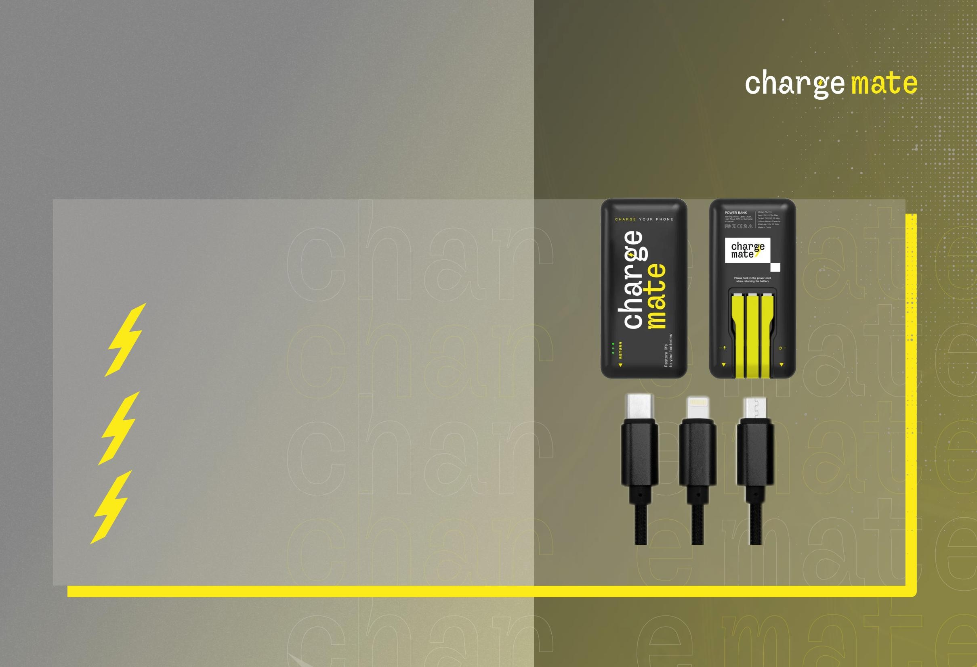
Power bank
Machine Translated by Google
Battery bank, capacity is 5000 mah.
5V-2A
Fast charging
Can charge 2 phones
*They are currently in use

Slide 9
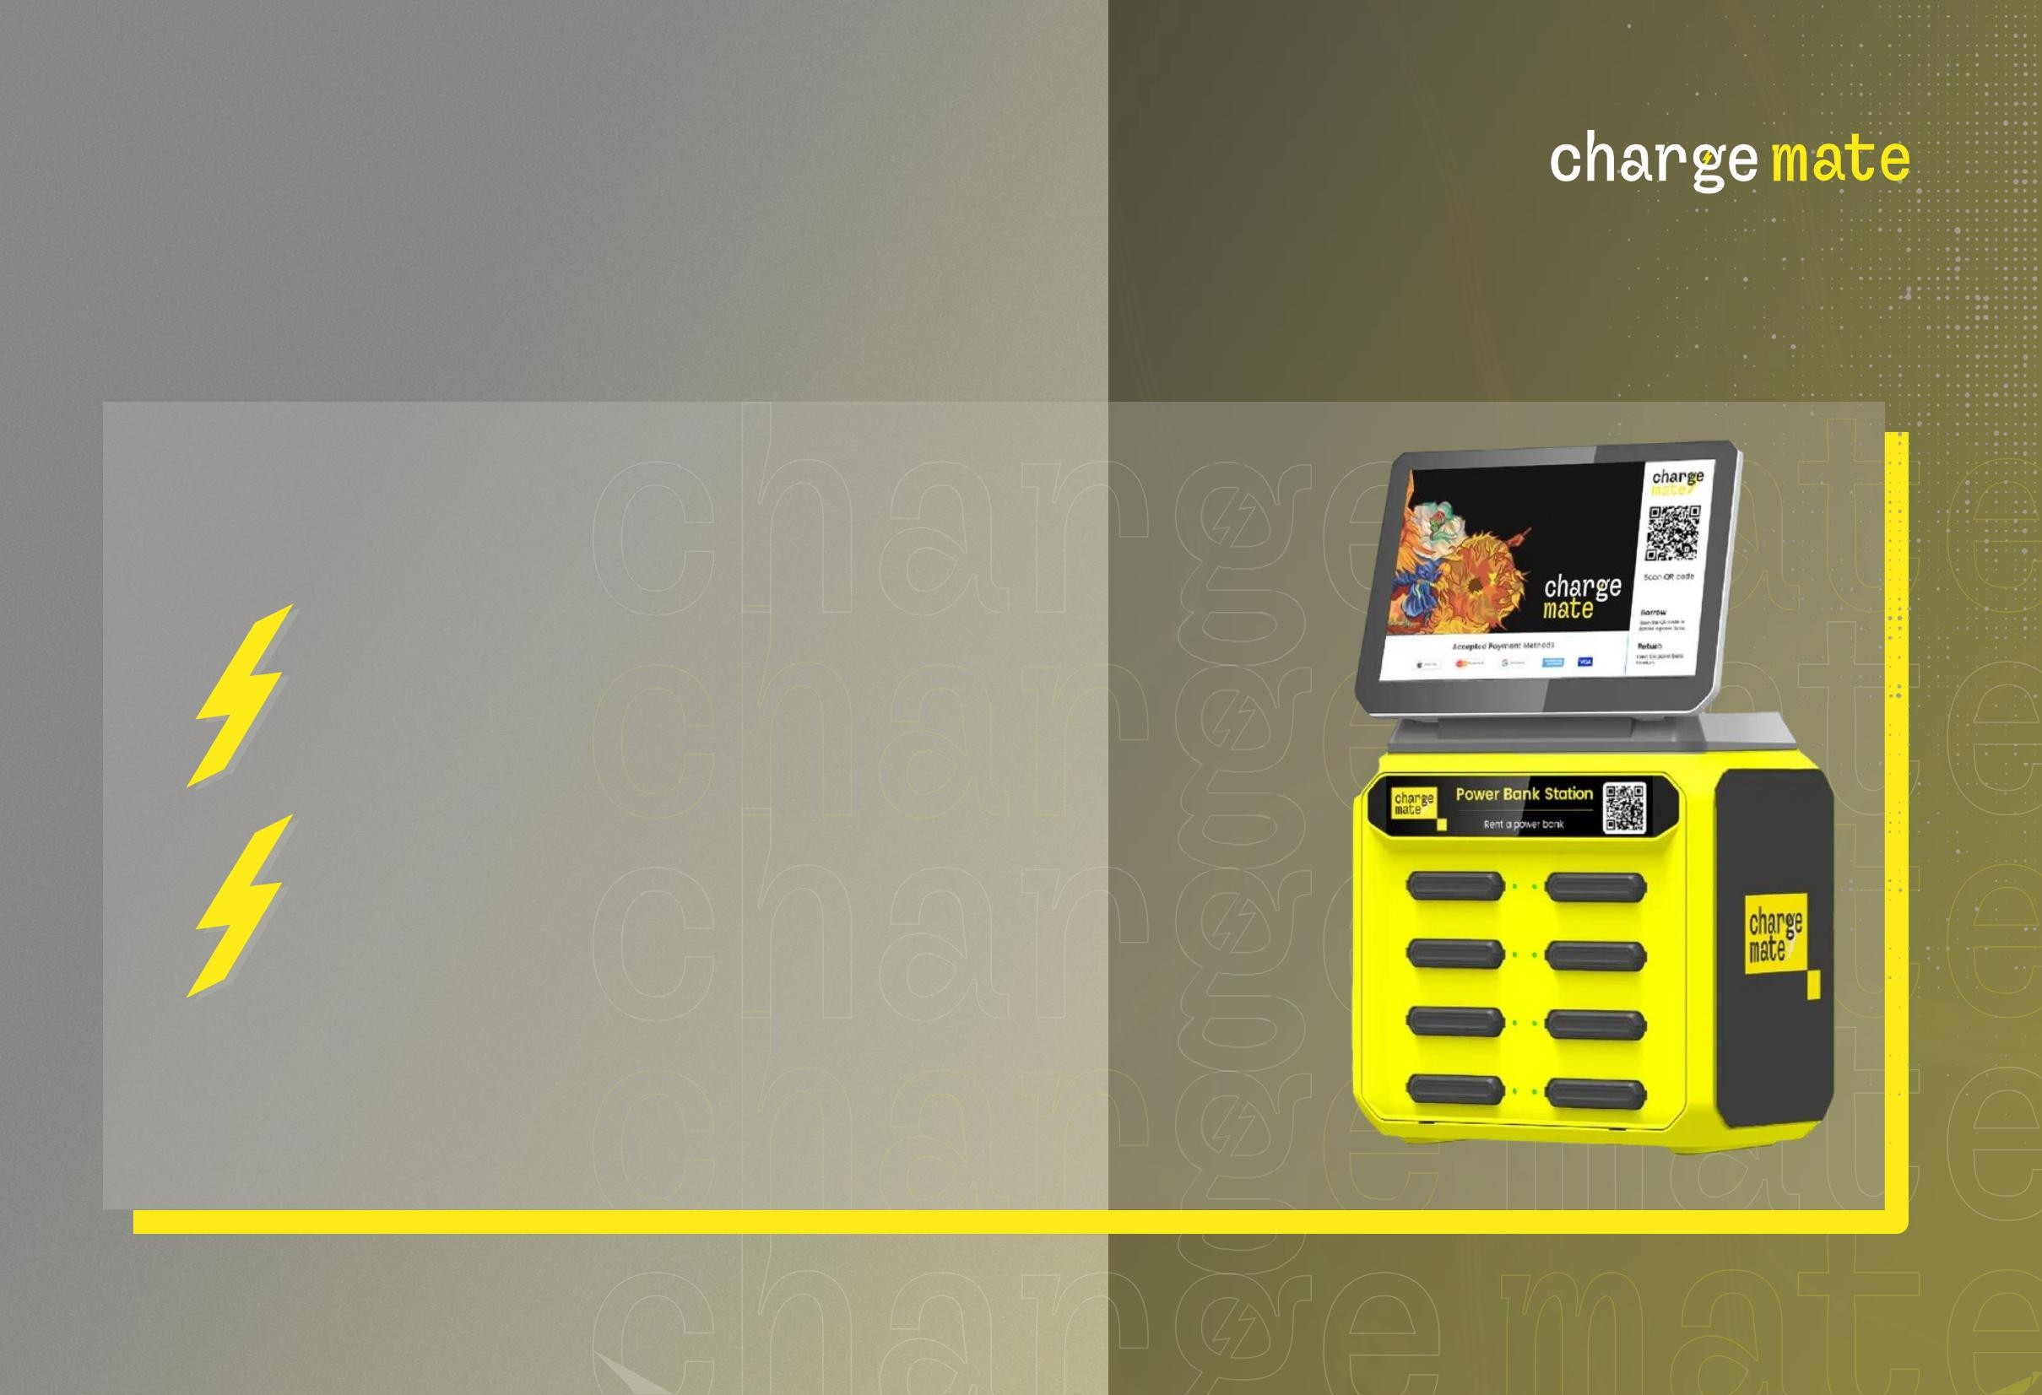
Small station
Machine Translated by Google
Charging station with 8 inputs.
8 battery banks,
which have a capacity of 5,000 mah.
*Currently they are more in use
Small

Slide 10
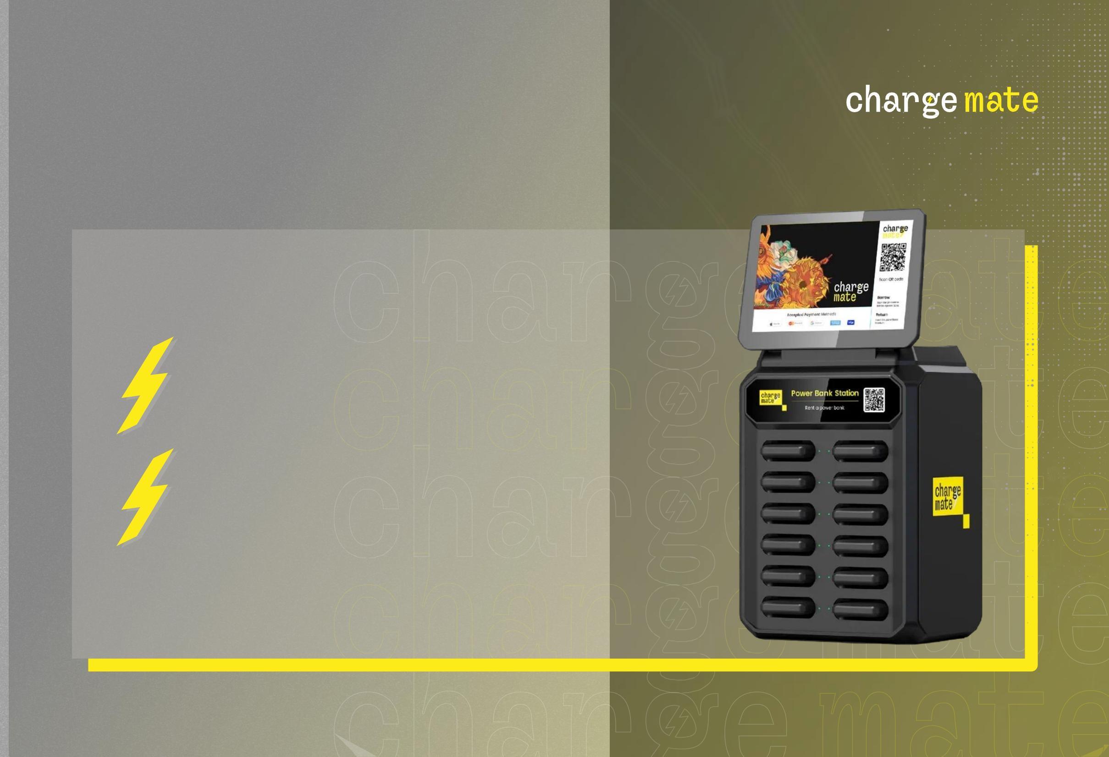
Medium station
Machine Translated by Google
Charging station with 12 inputs.
12 battery
banks with a capacity
of 5000 mah.
Medium

Slide 11
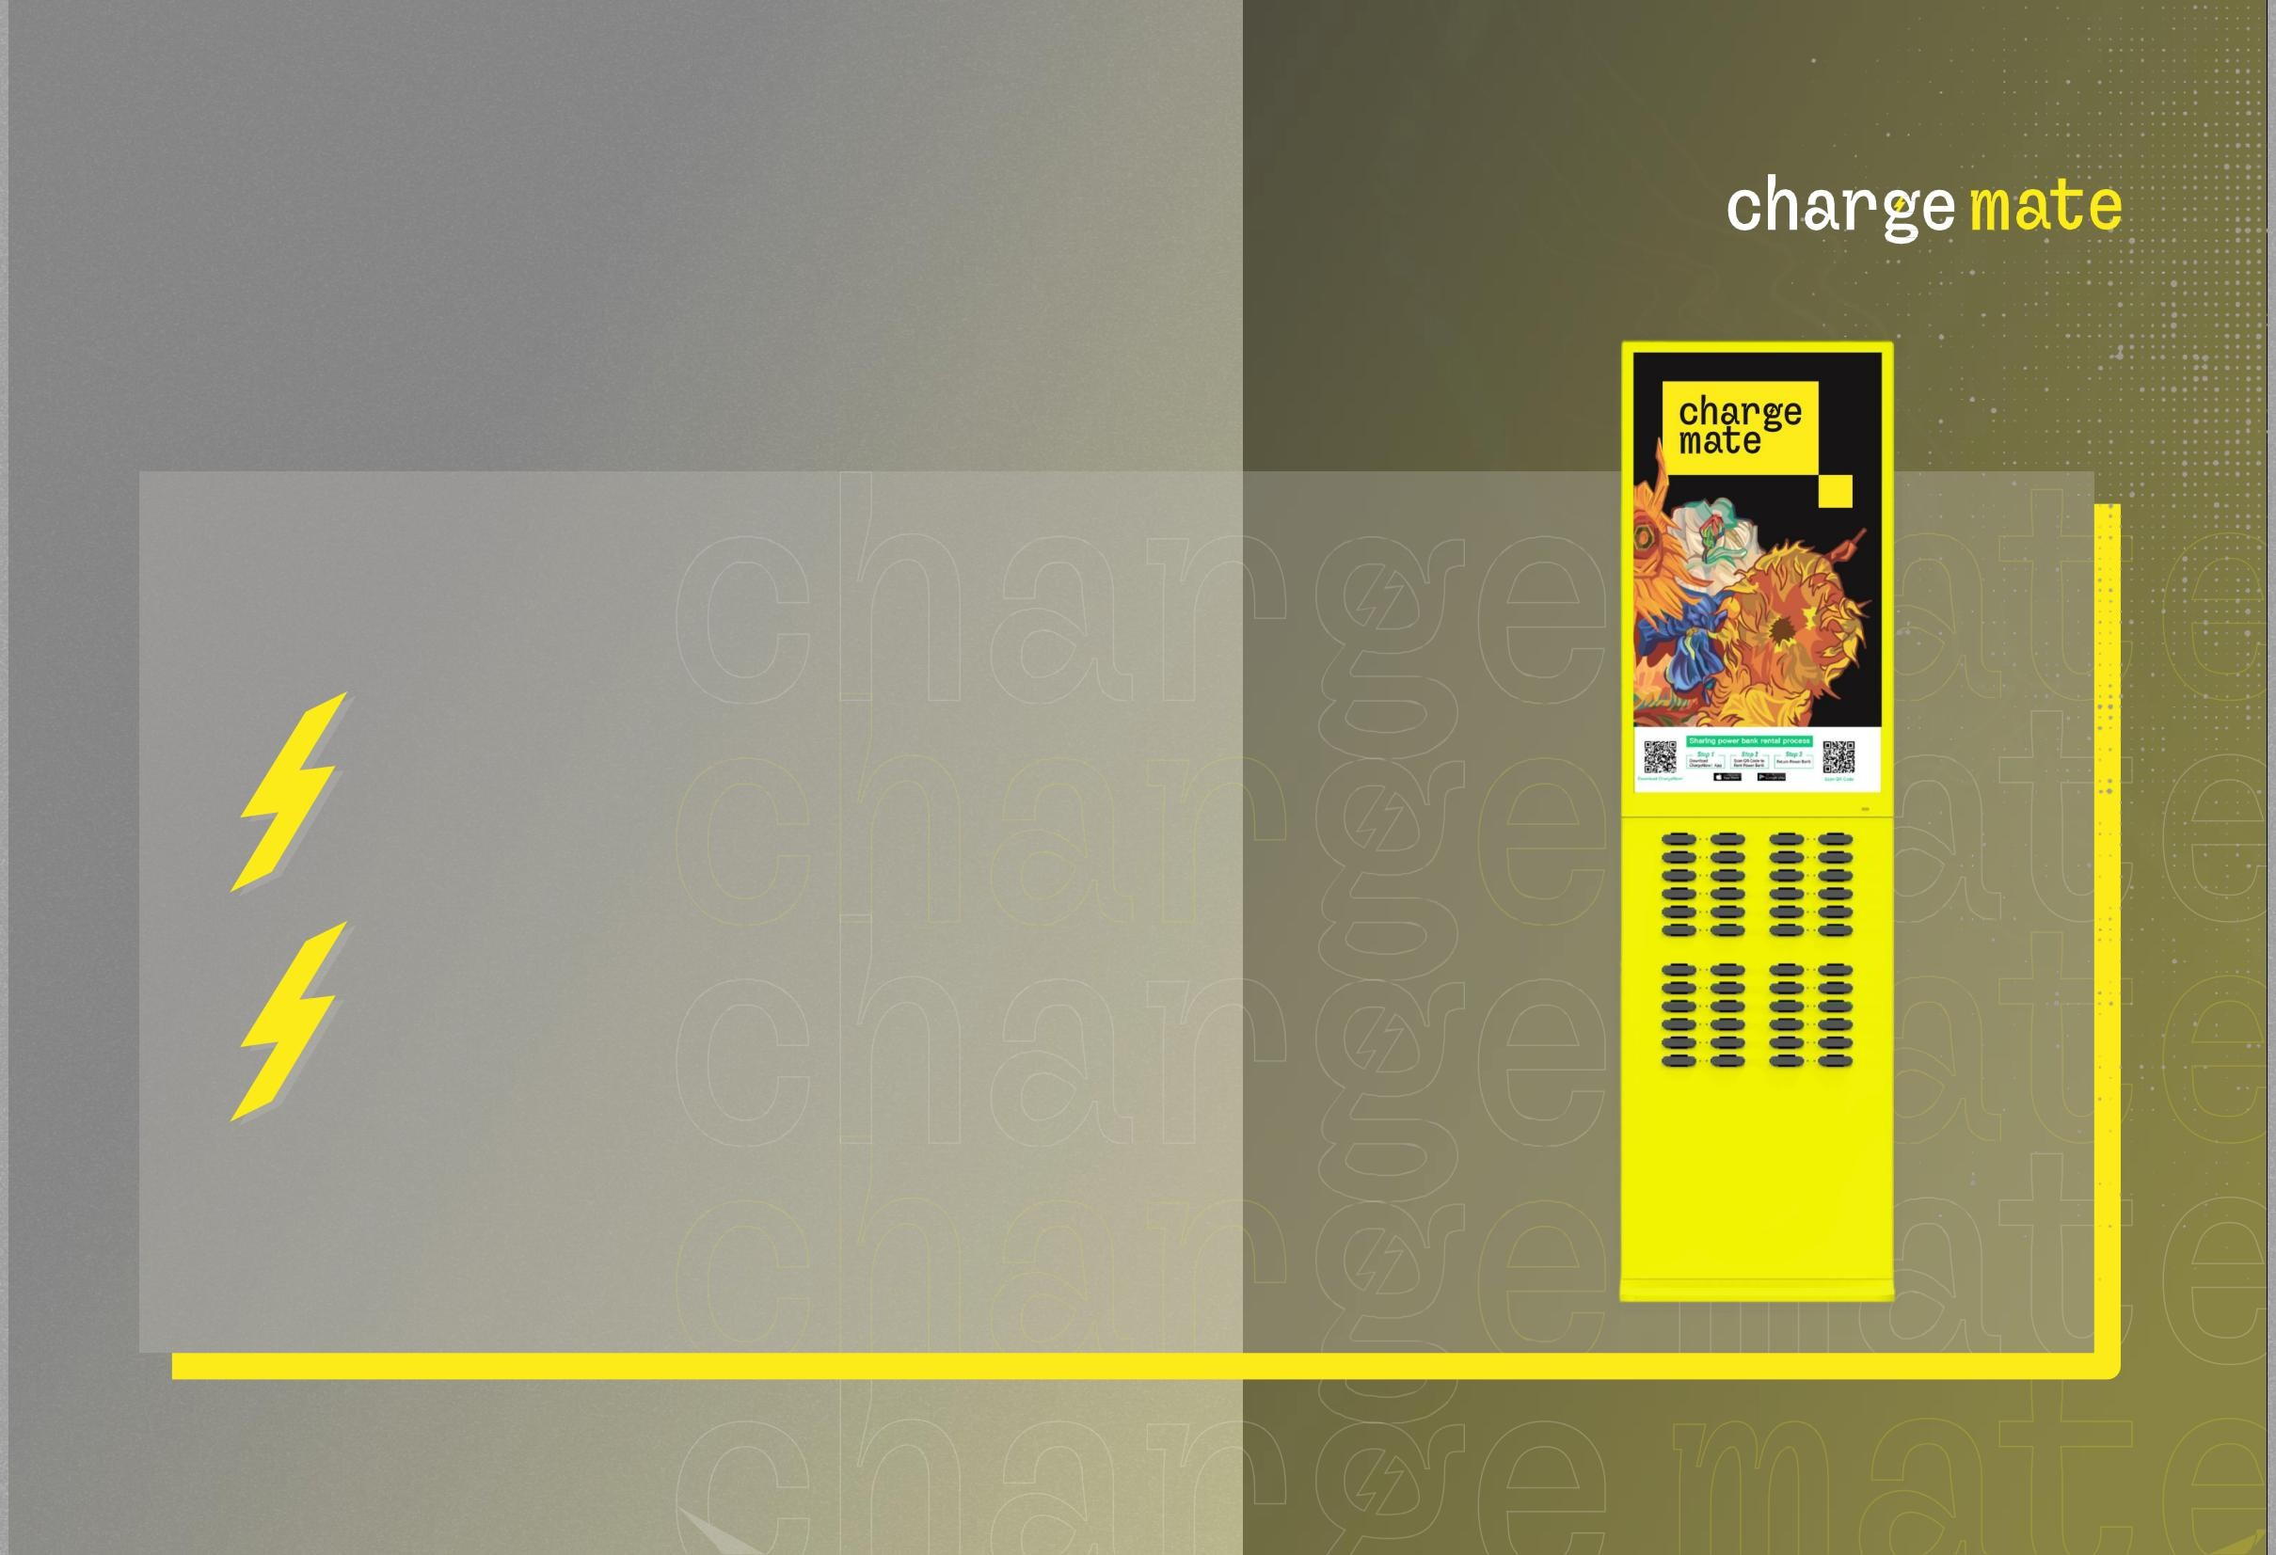
Large
Machine Translated by Google
station
Charging station with 48 inputs.
48 battery banks,
whose capacity is
5000 mah.
Large

Slide 12
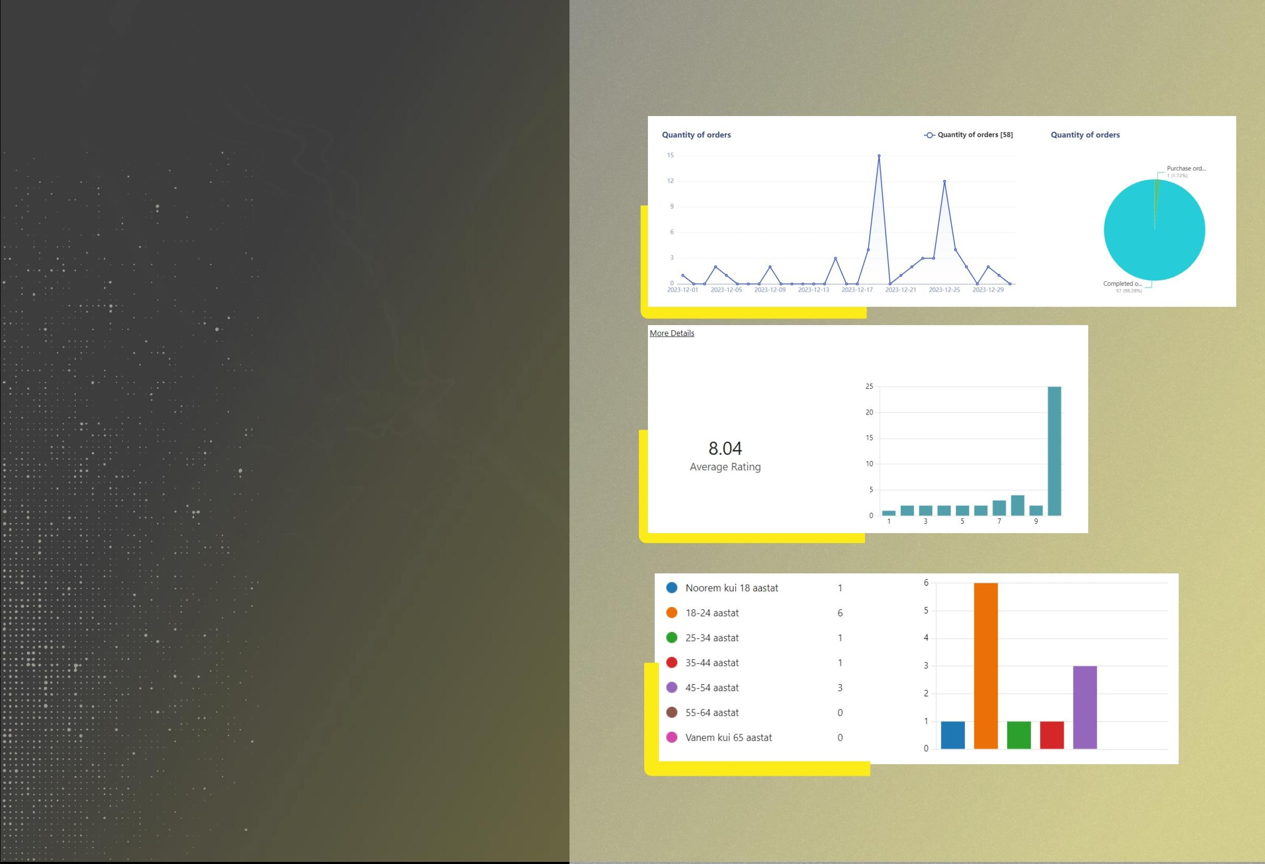
Current ones
results and research
Machine Translated by Google
ÿ From the end of November to the beginning of January registered users 101. Rented
the number of devices was 90.
ÿ When organizing various campaigns
the number of users has been steadily increasing.
In December, this indicator increased by 380%.
ÿ A person starts charging his phone necessity.
ÿ The most active users are young people
*currently, the project is gaining momentum, because the market does not really understand the nature of this product, it takes more time and advertising

Slide 13
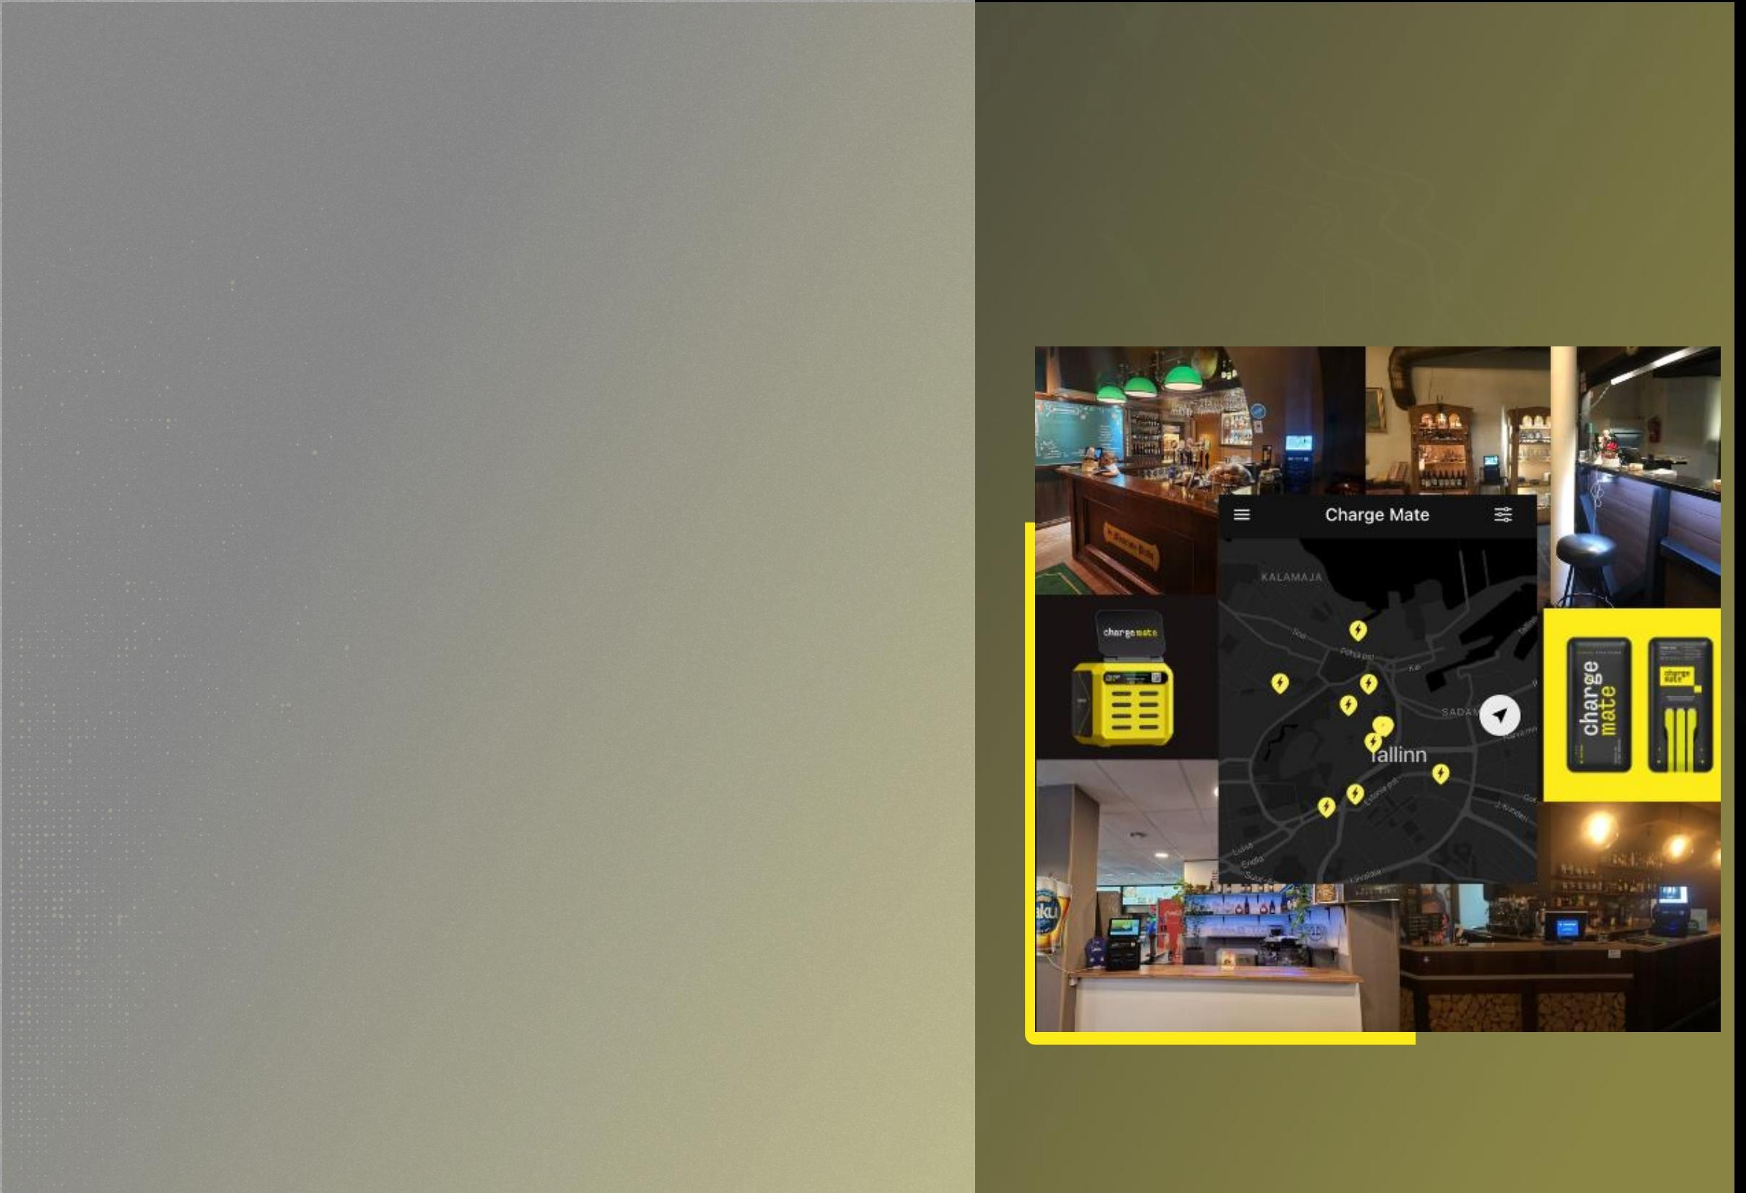
Current ones
results
Machine Translated by Google
ÿ 1 to 2 devices are rented from 12 stations every day.
ÿ The stations are located in different places, including restaurants (eg Tbilisi and Kagerou
Ramen), bars (e.g. Beer Garden, Uba and Hop) and sports clubs (e.g. Lemon Gym).
ÿ The number of users has been constantly increasing during the organization of various campaigns.
In December, this indicator increased by 380%.
*currently, the project is gaining momentum, because the market does not really understand the nature of this product, it takes more time and advertising

Slide 14
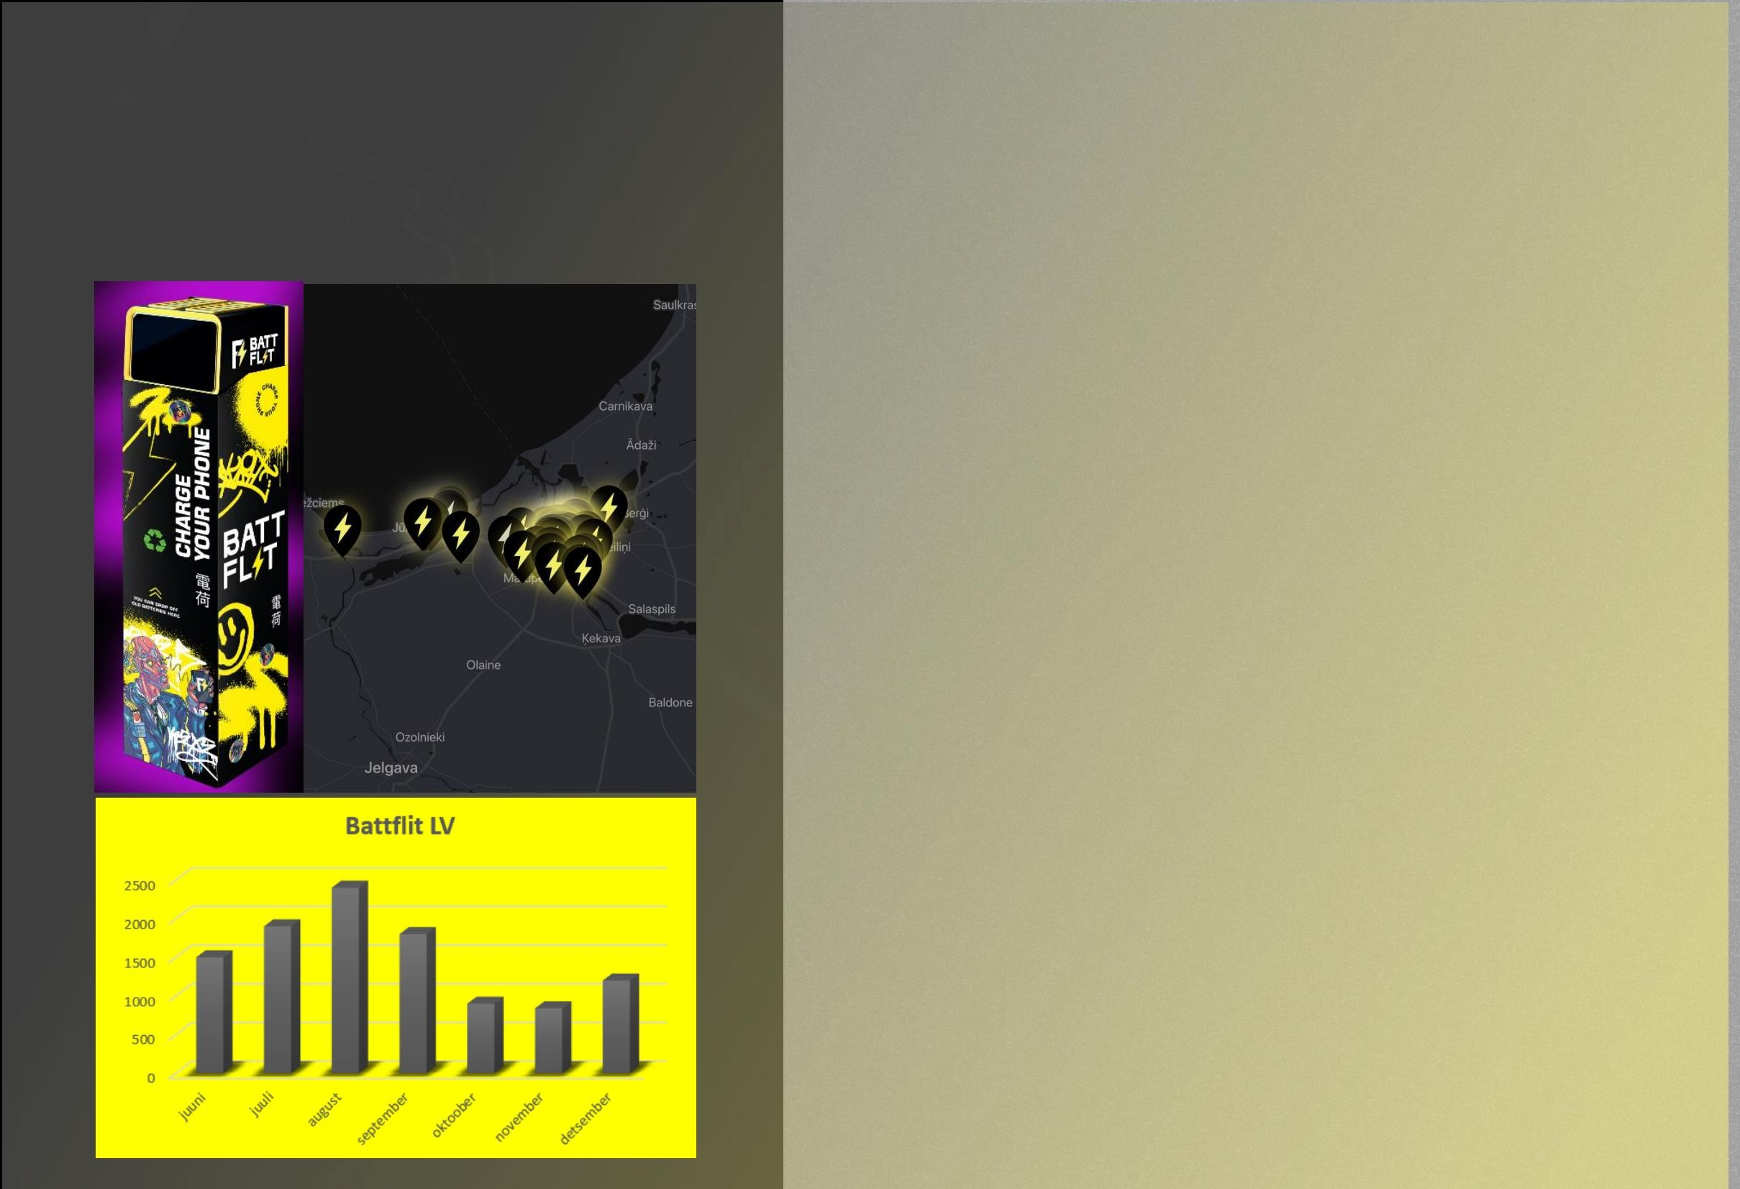
Market analysis
Machine Translated by Google
Battflit LV •
How long have they been in business?
Half a year. •
How many stations do
they have? 60. • How many users are there
now? 6250. • How long did the stations take to start up and gaining popularity to the current result?
What were the indicators in the first 2 months? They reached the current indicators in 3.5 months. • How many people are on their team now? 3 partners + employee. • How has
the money grown throughout the working period? June: 1500 euros
July: 1900 euros
August: 2400 euros
September: 1800 euros
October: 900 euros
November: 840 euros
December: 1200 euros+
Advertising: 700 euros

Slide 15
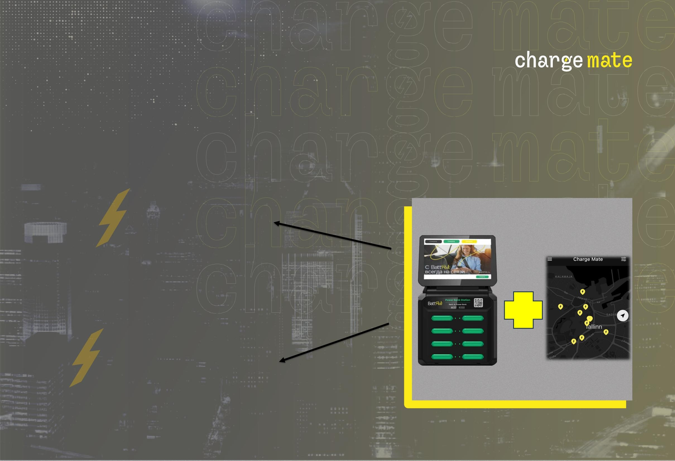
Earning opportunities
Machine Translated by Google
Advertising
Rental of battery banks

Slide 16
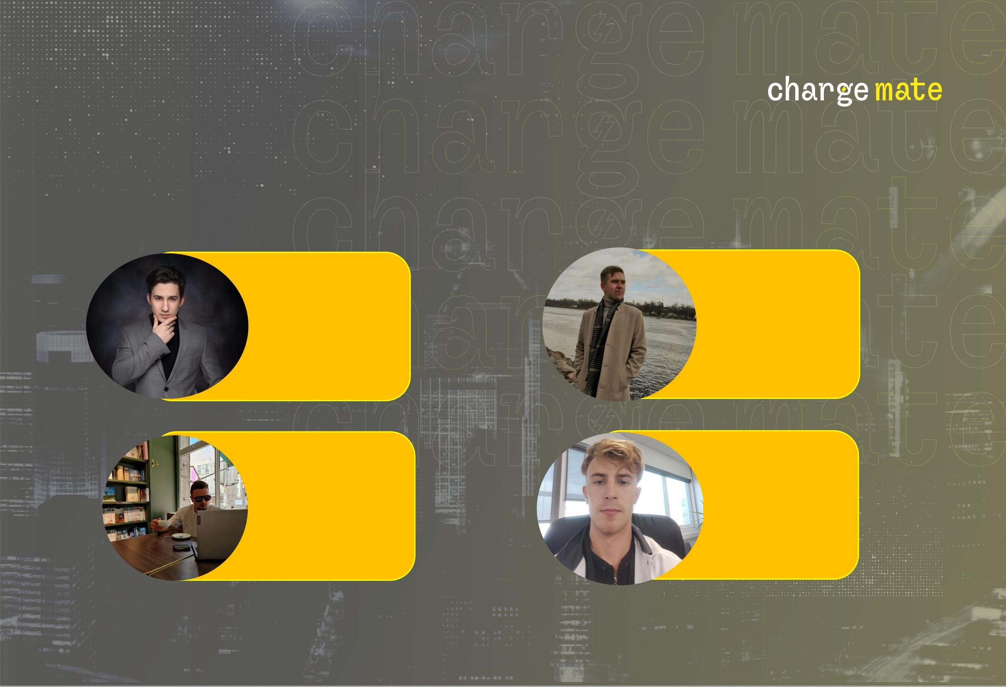
The team
Machine Translated by Google
Vasiliy Bezlyudnyy
Team Leader, Chairman of the Board
Ruslan Bezrukov
Marketing advertising
and design specialist
Emil Morozov Board member, technical and
maintenance specialist
Oliver Siem
Business partner,
marketing and management assistant

Slide 17
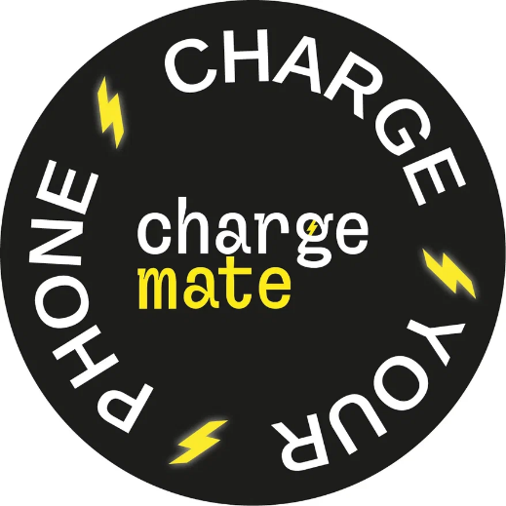
Forecast of products
Toote/teenuse andmed - asendage sinise kirjaga lahtrid oma toodete/teenusetega ning õigete käibemaksumääradega! |  |  | nov.23 | dets.23 | jaan.24 | veebr.24 | märts.24 | apr.24 | mai.24 | juuni.24 | juuli.24 | aug.24 | sept.24 | okt.24 | 1.aasta | 2.aasta | 3.aasta
akupankade 1 tunni rent |  | toodetav kogus kokku | 0 | 30 | 50 | 90 | 180 | 300 | 600 | 800 | 1000 | 1200 | 1500 | 1800 | 7550 | 34944 | 45696
 |  | sh ekspordiks %-des | 0% | 0% | 0% | 0% | 0% | 0% | 0% | 0% | 0% | 0% | 0% | 0% |  | 0% | 0%
 |  | keskm.ühiku müügihind KM-ta | 1,20 | 1,20 | 1,20 | 1,20 | 1,20 | 1,20 | 1,20 | 1,20 | 1,20 | 1,20 | 1,20 | 1,20 |  | 1,20 | 1,20
20% | 0% | Kokku toote nr. 1 käive
akupankade päeva rent |  | toodetav kogus kokku | 0,00 | 36,00 | 60,00 | 108,00 | 216,00 | 360,00 | 720,00 | 960,00 | 1 200,00 | 1 440,00 | 1 800,00 | 2 160,00 | 9 060,00 | 41 932,80 | 54 835,20
 |  | sh ekspordiks %-des | 0,00 | 0,00 | 1,50 | 2,70 | 5 | 9 | 18 | 24 | 30 | 36 | 45 | 54 | 226 | 400 | 450
 |  | keskm.ühiku müügihind KM-ta | 0% | 0% | 0% | 0% | 0% | 0% | 0% | 0% | 0% | 0% | 0% | 0%
20% | 0% | Kokku toote nr. 2 käive | 3,60 | 3,60 | 3,60 | 3,60 | 3,60 | 3,60 | 3,60 | 3,60 | 3,60 | 3,60 | 3,60 | 3,60 |  | 3,60 | 4,00
Jaamas esindatud reklaam |  | toodetav kogus kokku
 |  | sh ekspordiks %-des | 0,00 | 0,00 | 5,40 | 9,72 | 19,44 | 32,40 | 64,80 | 86,40 | 108,00 | 129,60 | 162,00 | 194,40 | 812,16 | 1 440,00 | 1 800,00
 |  | keskm.ühiku müügihind KM-ta | 0 | 1 | 1 | 2 | 5 | 5 | 5 | 5 | 5 | 5 | 5 | 5 | 44 | 60 | 60
20% | 0% | Kokku toote nr. 3 käive | 0% | 0% | 0% | 0% | 0% | 0% | 0% | 0% | 0% | 0% | 0% | 0%
akupankade varastamine |  | toodetav kogus kokku | 50,00 | 50,00 | 50,00 | 50,00 | 100,00 | 150,00 | 200,00 | 200,00 | 200,00 | 200,00 | 200,00 | 200,00 |  | 350,00 | 350,00
 |  | sh ekspordiks %-des
 |  | keskm.ühiku müügihind KM-ta | 0,00 | 50,00 | 50,00 | 100,00 | 500,00 | 750,00 | 1 000,00 | 1 000,00 | 1 000,00 | 1 000,00 | 1 000,00 | 1 000,00 | 7 450,00 | 21 000,00 | 21 000,00
20% | 0% | Kokku toote nr. 4 käive | 0 | 0 | 0 | 0 | 0 | 0 | 0 | 1 | 1 | 1 | 1 | 1 | 5 | 7 | 10

Slide 18

Rent forecasts
Machine Translated by Google
Powerbank rental (does not include: 20% operational cost) First 5 minutes free Hourly price is
1.5 euros Daily price is 5 euros Example Station (8 ports)-32 stations
Average alignment Calculating 1
energy bank in 1 station if you use 1 hour.
Negative Alignment
Counting 6 power banks in one station if you use 1 hour.
Positive Alignment
Counting 4
power banks in one station if you use 1 hour.
1*2=2 euros per day
2*32= 64 euros per day from 32 stations
0.3 *2=0.6 euros per day 0.6*32= 19.2 euros per day from 32 stations
4*2=8 euros per day
8*32= 256 euros per day from 32 stations
A total of 1792 euros per month
A total of 570 euros per month
A total of 7168 euros per month

Slide 19

Machine Translated by Google
NEEDED
FOR PILOT START IN ESTONIA
28,000 euros.
A necessary investment
28,000 euros
25000 – Purchase of 50 stations
3000 - Marketing
1000 - installation costs

Slide 20
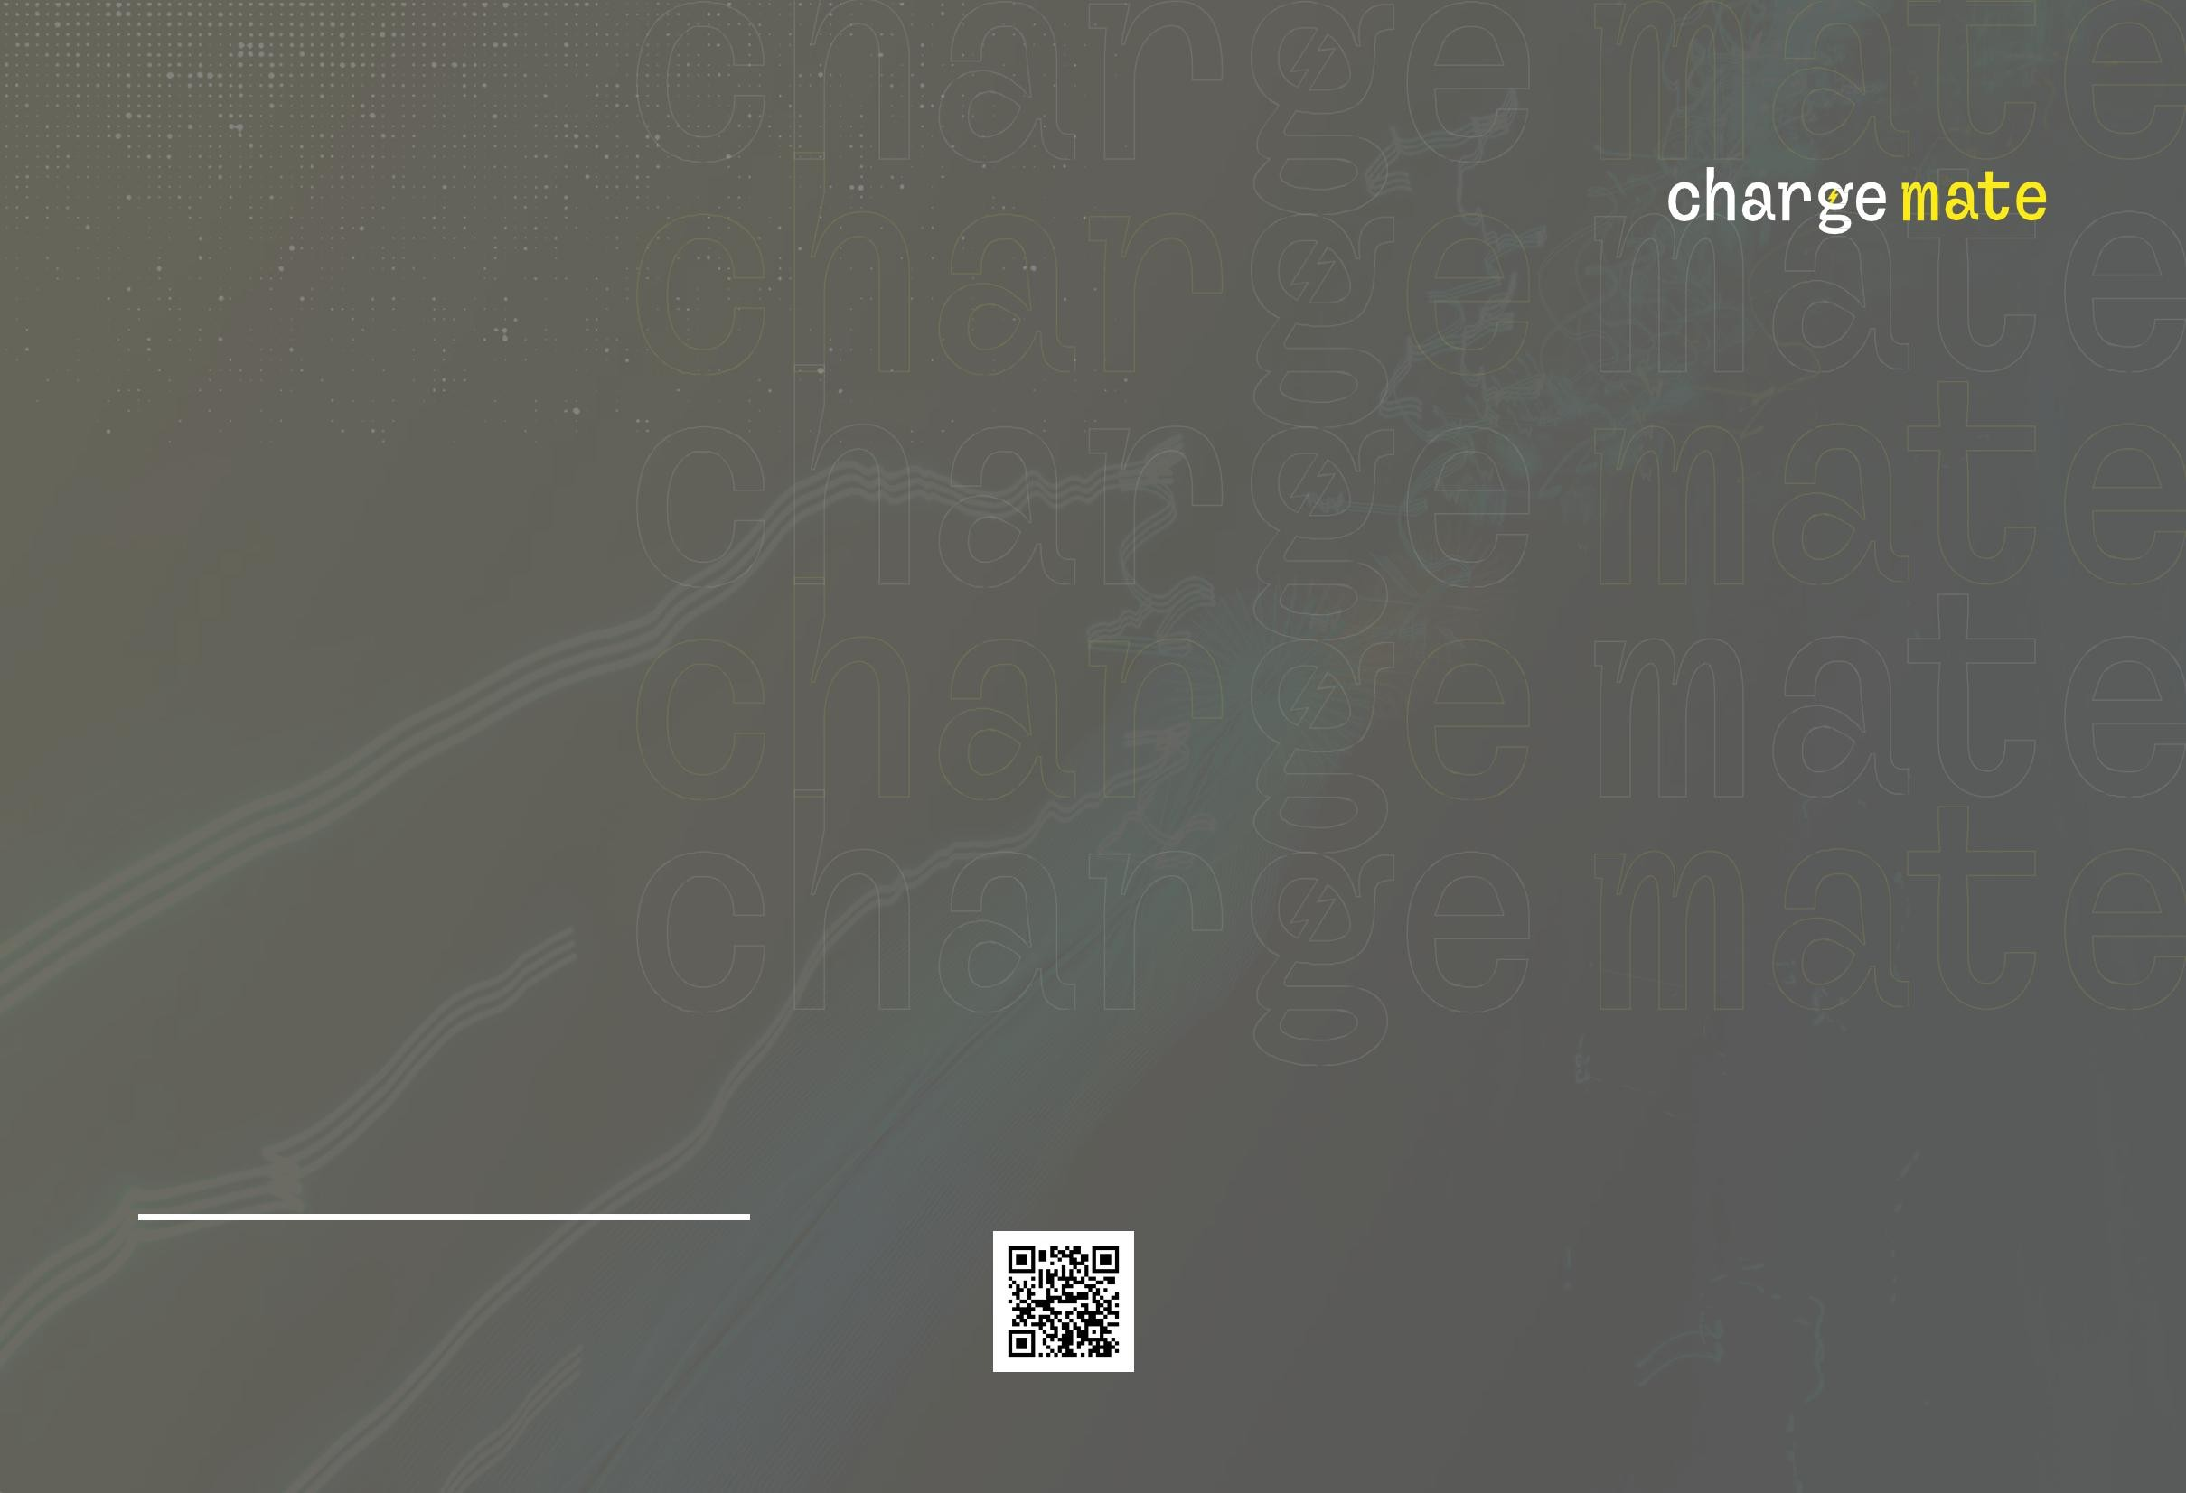
Contacts
Machine Translated by Google
morbezl@gmail.com Instagram: chargemate_eu
+37253023333

